Slide 1
A Brief report on: Integrative clustering of multiple genomic data types using a joint latent variable model with application to breast and lung cancer subtype analysis (Ronglai Shen, Adam B. Olshen, and Marc Ladanyi,2009)
By Linglin Huang
2013.05

Slide 2
Presentation Structure
A summary of the paper
A detailed exploration of the ideas introduced and developed in the paper
Some questions remained

Slide 3
Summary
Methods
Eigengene K-means algorithm
Gaussian latent variable model representation
iCluster: a joint latent variable model-based clustering method
Sparse solution
Model selection based on cluster separability
Results
Subtype discovery in breast cancer
Lung cancer subtypes jointly defined by copy number and gene expression data

Slide 4
1.1 Eigengene K-means algorithm
Let X denote the mean-centered expression data of dimension $p×n$ with rows being genes and columns being samples.
X={x₁, ..., x_{n}},
where x_{i} represents the i^{th} sample.

Slide 5
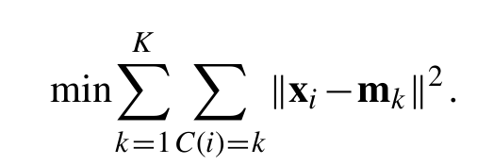
1.1. Eigengene K-means algorithm
Given a partition C of the column space of X and the corresponding cluster mean vectors{m₁, ··· , m_{K}}, the sample vectors X are assigned cluster membership such that the sum of within-cluster squared distances is minimized:

Slide 6
1.1. Eigengene K-means algorithm
This formula can iterate to local minima rather than the global maximum.
Let Z = ( z₁,..., z_{K})’ with the k^{th} row being the indicator vector of cluster k normalized to have unit length:
where n_{k} is the number of samples in cluster k and
$$\sum_{k=1}^{K}{n_{k}}=n$$

Slide 7
1.1. Eigengene K-means algorithm
Let X’X be the Gram matrix of the samples.
Now consider a continuous Z∗ that satisfies all the conditions of Z except for the discrete structure. Then the above is equivalent to the eigenvalue decomposition of the sample covariance matrix S.
Therefore, a closed-form solution of (3) is $\hat{Z}$∗= E , where E = ( e₁,..., e_{K})are the eigenvectors corresponding to the K largest eigenvalues from the eigenvalue decomposition of S.
Because of the redundancy in Z, the K -means solution can be defined by the first K−1 eigenvectors.

Slide 8
1.1. Eigengene K-means algorithm
The discrete structure in Z and its interpretability can be easily restored by a simple mapping by a pivoted QR decomposition or a standard K-means algorithm invoked on Z∗.

Slide 9
1.2. Gaussian latent variable model representation
where X is the mean-centered expression matrix of dimension p×n (no intercept), Z = ( z₁,..., z_{K−1})’ is the cluster indicator matrix of dimension (K − 1)×n as defined in 1.1, W is the coefficient matrix of dimension p×(K − 1), and ε=(ε₁,...,ε_{p})’ is a set of independent error terms with zero mean and a diagonal covariance matrix Cov (ε) =$Ψ$ ,where$Ψ$= diag($ψ$₁ ,...,$ψ$_{p}).

Slide 10
1.2. Gaussian latent variable model representation
Consider a continuous parameterization Z∗ of Z and make the additional assumption that Z∗∼N(0,$I$) and ε∼N(0,$Ψ$). Then a likelihood-based solution to the K-means problem is available.

Slide 11
1.2. Gaussian latent variable model representation
The motivation for formulating the K-means problem as a Gaussian latent variable model is 2-fold:
(i) it provides a probabilistic inference framework;
(ii) the latent variable model has a natural extension to multiple data types. In the next section, we propose a joint latent variable model for integrative clustering.

Slide 12
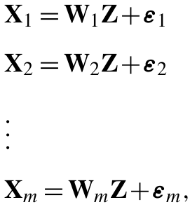
1.3. iCluster: a joint latent variable model-based clustering method
Basic concept of iCluster:
Jointly estimate Z=( z₁,..., z_{K −1}), the latent tumor subtypes, from, say, DNA copy number data (denoted by X₁,a matrix of dimension p₁×n ), DNA methylation data (denoted by X₂,a matrix of dimension p₂×n ), mRNA expression data (denoted by X₃, a matrix of dimension p₃×n ) and so forth.

Slide 13
1.3. iCluster: a joint latent variable model-based clustering method
Z is the latent component that connects the m -set of models, inducing dependencies across the data types measured on the same set of tumors.
The independent error terms (ε₁,..., ε_{m}), in which each has mean zero and diagonal covariance matrix $Ψ_{i}$, represent the remaining variances unique to each data type after accounting for the correlation across data types.
(W₁,..., W_{m}) denote the coefficient matrices. In dimension reduction terms, they embed a simultaneous data projection mechanism that maximizes the correlation between data types.

Slide 14
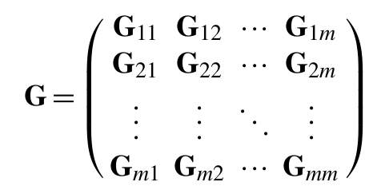
1.3. iCluster: a joint latent variable model-based clustering method
Assume
Z∗∼N(0,$Ι$)
ε ∼ N ( 0 , $Ψ$), $Ψ=$diag($ψ$₁ ,...,$ψ_{\sum_{i}{p_{i}}}$)
The marginal distribution of the integrated data matrix X = ( X₁,..., X_{m})’is then multivariate normal with mean zero and covariance matrix $Σ$ = WW’+ $Ψ$, where W= ( W₁,..., W_{m})’.
Denote the sample covariance matrix as

Slide 15
1.3. iCluster: a joint latent variable model-based clustering method
The corresponding log-likelihood function of the data is
To employ EM algorithm, we deal with the complete-data log-likelihood

Slide 16
1.4. Sparse solution
Penalized complete data log-likelihood
A lasso type ( L₁-norm) penalty

Slide 17
1.4. Sparse solution
With the E and M steps, we obtain the following estimation:
where
After obtaining$\hat{E}[Z^{∗}|X]$ , invoke a standard K -means on $\hat{E}\left[Z^{∗} | X\right]$to recover the class indicator matrix.
Denote this solution as${\hat{Z}}_{iCluster}$.

Slide 18
1.5. Model selection based on cluster separability
Let be ordered such that samples belonging to the same clusters are adjacent.
Standardize the elements of ${\hat{B}}^{∗}$to be $b_{ij}/\sqrt{b_{ii}b_{jj}}$ for i=1,..., n and j=1,..., n, and impose a non-negative constraint by setting negative values to zero.

Slide 19
1.5. Model selection based on cluster separability
Define a deviance measure d as the sum of absolute differences between ${\hat{B}}^{∗}$and a “perfect” diagonal block matrices of 1s and 0s.
Define the proportion of deviance (POD) as d/n².
Then POD is between 0 and 1. Small values of POD indicate strong cluster separability, and large values of POD indicate poor cluster separability.
POD can be used in estimating the number of clusters K and the lasso parameter λ.

Slide 20
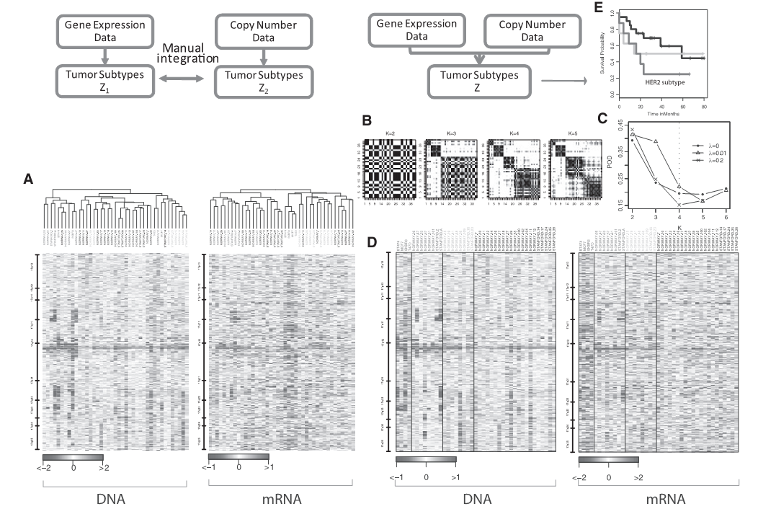
2.1. Subtype discovery in breast cancer

Slide 21
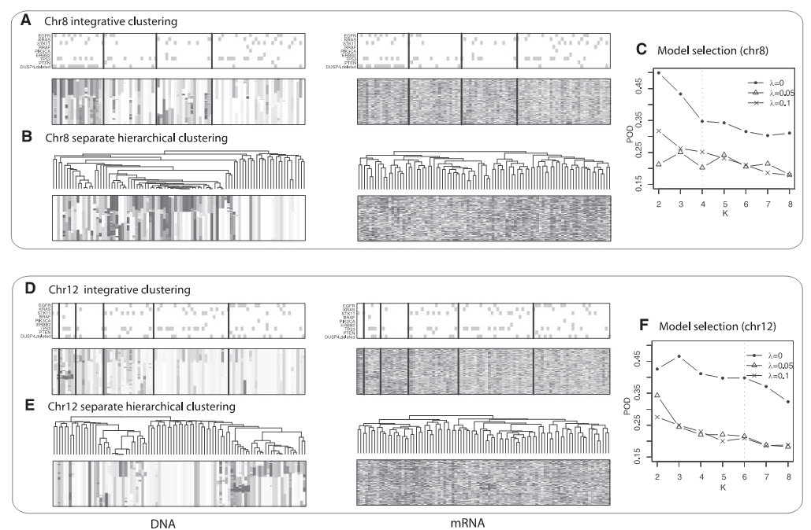
2.2. Lung cancer subtypes jointly defined by copy number and gene expression data

Slide 22
3. Questions
1. Some computational results might not be right.
While looking for the sparse solution via the EM algorithm, the estimations of $E\left[Z^{∗} | X\right]$ and $E\left[Z^{∗}Z^{∗′} | X\right]$in the paper are
But the above results requires a diagonal structure of $Ψ$, which is not mentioned in the corresponding section.

Slide 23
3. Questions
In fact, I believe the estimations should be as following:
$E\left[Z^{∗} | X\right]=M^{−1}W^{′}Ψ^{−1}X$,
$E\left[Z^{∗}Z^{∗′} | X\right]=M+E\left[Z^{∗} | X\right]E\left[Z^{∗} | X\right]′$.
where $M=W^{′}Ψ^{−1}W+I$.

Slide 24
3. Questions
2. What if the data are not of the same dimension?
In the paper, the authors assume that data of every sample and every data type are complete and equal-dimensional.
But there might be some differences in the dimensions of data among different samples and different data types.
For example, the mRNA expression data and DNA methylation data might do not contain the information of a certain gene at the same time.
In this situation, can iCluster still function well?

Slide 25
Thank you!

