Slide 1
Inferring causal genomic alterations in breast cancer using gene expression data(Linh M Tran et.al)
By Linglin Huang

Slide 2
Abstract
Background:
  identify causal genomic alterations in cancer research
  many valuable studies lack genomic data to detect CNV
  infer CNVs from gene expression data
Results:
  a framework for identifying recurrent regions of CNV and distinguishing the cancer driver genes from the passenger genes in the regions
  109 recurrent amplified/deleted CNV regions
  include not only well-known oncogenes but also a number of novel cancer susceptibility genes validated via siRNA experiments
Conclusion:
  the first effort to systematically identify and valid ate drivers for expression based CNV regions in breast cancer
  can be applied to many other large-scale gene expression studies and other novel types of cancer data

Slide 3
Structure
methods
results
discussion

Slide 4
Methods
Preprocessing
data
WACE
algorithm
Gene Regulatory
Inferred CNV
Network
Regions
Key Driver Analysis
Putative Causal
Regulators
back

Slide 5
Preprocessing
four independent breast cancer datasets
adjusted for estrogen and progesterone receptor(ER/PR) status as well as age
Fit data using a robust linear regression model; the residuals were carried forward in all subsequence analyses as the gene expression traits
gene expression and aCGH data from the Stanford University Breast Cancer Study
back

Slide 6
WACE
Sample of
Sample of
phenotype
1
phenotype
2
Expression
Score
(
ES
)
of each
gene
:
t
-
score
Randomly permute
Arrange ES by
Sample labels in
gene physical
calculating ES
location
Neighboring Score
(
NS
)
of each gene
:
Discrete
Wavelet transform
Significant
NS
back

Slide 7
ICNV
Inferred Copy Number Variation region
Criteria:
  False discovery rate:
    the fraction of random NS that were greater than (less than) or equal to the observed value if NS>0 (NS<0)
  Number of consecutive positive/negative NS’s
    false discovery rate less than or equal to 0.01

Slide 8
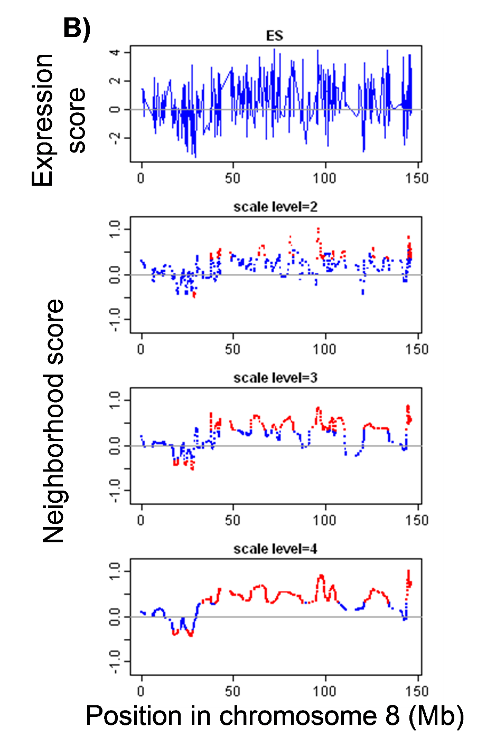
ICNV
Figure showed that the high scaling level of wavelet transform increased the NS magnitude of neighbor points around a single differentiated gene, and made them become statistical significant, which might in turn falsely identify region as ICNV if n was small.

Slide 9
ICNV
ensure more than a single gene in the region being differentiated
n ranged from 5 to 10 depending on the scaling levels of wavelet transform
In this project, we used n = 5 for s = 3, which was used in the four high gene-density breast cancer datasets, and n = 10 for s = 5, which was used in the BSC1 low gene-density dataset.

Slide 10
ICNV
recurrent regions of ICNV:
  align the ICNV regions in multiple datasets to determine if they overlap
  the union of the overlap ICNVs
back

Slide 11
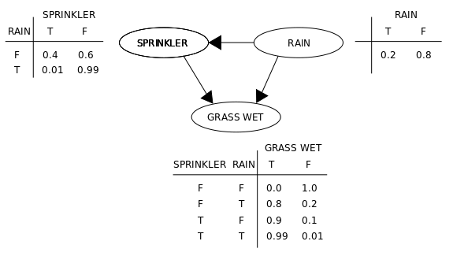
Gene Regulatory Network
Bayes(ian) Networks(belief network, Bayes(ian) model; probabilistic directed acyclic graphical model):
  a probabilistic graphical model
  represents a set of random variables and their conditional dependencies via a directed acyclic graph (DAG)

Slide 12
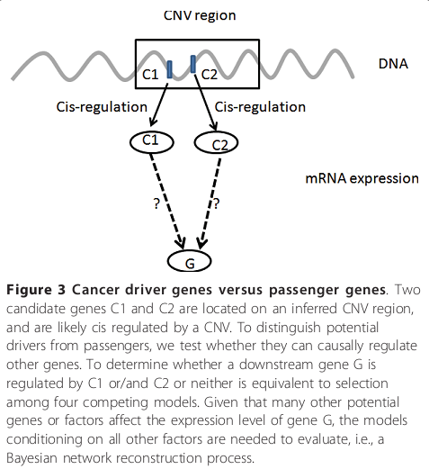
Gene Regulatory Network
Four whole-genome gene regulatory networks were constructed
Combine the four networks by union of directed links to form a single network
back

Slide 13

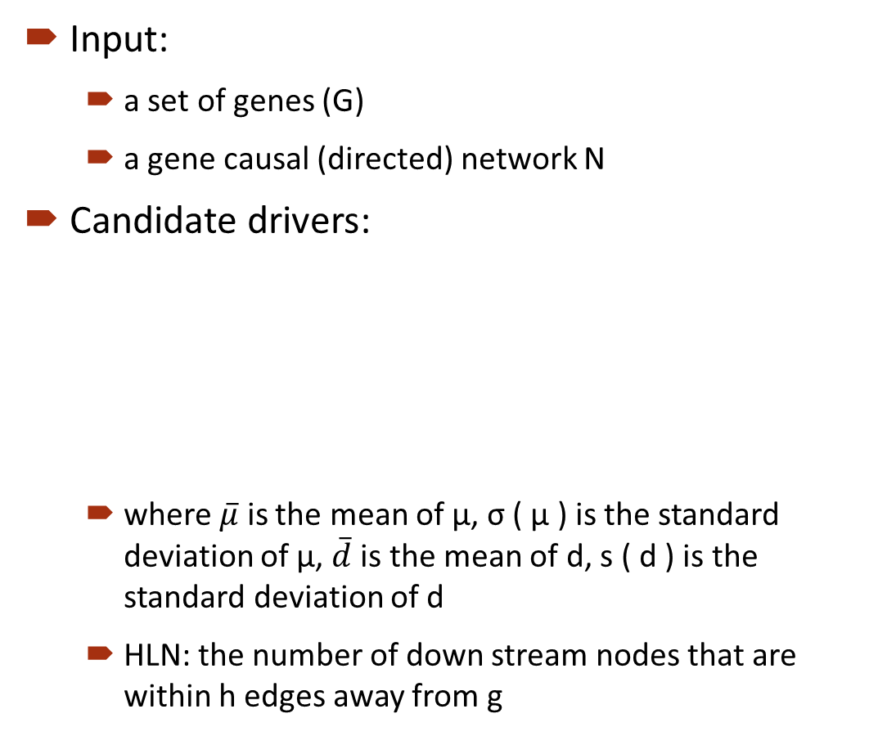



Key Driver Analysis(KDA)
Input:
  a set of genes (G)
  a gene causal (directed) network N
Candidate drivers:
  where $\overline{μ}$ is the mean of μ, σ ( μ ) is the standard deviation of μ, $\overline{d}$ is the mean of d, s ( d ) is the standard deviation of d
  HLN: the number of down stream nodes that are within h edges away from g
No parent nodes
  HLN > $\overline{μ}$ + σ ( μ )
d > $\overline{d}$+ σ ( d )
Global drivers
  HLN < $\overline{μ}$ + σ ( μ )
Have parent nodes
d < $\overline{d}$+ σ ( d )
Local drivers
back

Slide 14
data classification
Criterion:
  a given clinical phenotype of interest, such as poor versus good outcome
Number of classes:
  2
Reason:
  the ES’s would be computed for each gene with respect to the two groups
back

Slide 15
ES
The expression score (ES) for each gene is first calculated according to the correlation of its expression with the phenotypes in comparison.
t-statistics are used to score gene expression
back

Slide 16
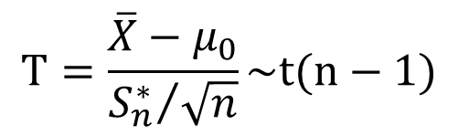
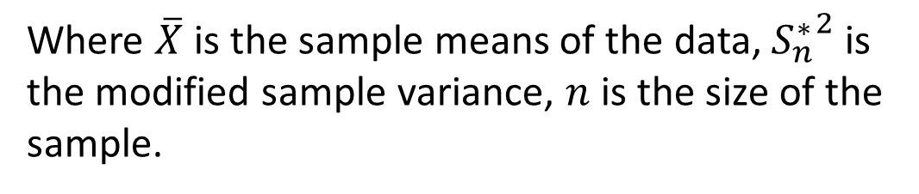

t-statistics
$$H_{0}：μ=μ_{0}↔H_{1}：μ≠μ_{0}$$
$$T=\frac{\overline{X}−μ_{0}}{{S_{n}^{∗}}/{\sqrt{n}}}\sim t(n−1)$$
Where $\overline{X}$ is the sample means of the data, ${S_{n}^{∗}}^{2}$ is the modified sample variance, $n$ is the size of the sample.
back

Slide 17
NS
The ES’s were then subjected to a smoothing procedure in which neighborhood data points are incorporated in de-noising the point of interest. In our algorithm, we used a wavelet transform to obtain the NS’s.

Slide 18
NS
Wavelet transform:
  The wavelet transform is a sophisticated filtering or smoothing technique.
  It has the superior ability to accurately deconstruct and reconstruct finite, non-periodic and/or non-stationary signals.
  Different from traditional filtering techniques (e.g. Fourier transform) which are defined on the time space, wavelet transform is defined on the time-scale space.

Slide 19
NS
Wavelet transform:
where is a given input signal
is a wavelet function at scale a and position s.
The signal can then be reconstructed again from inverse wavelet transform:
where C is a constant.

Slide 20
NS
Parameter selection: filter and scaling level
Filter function:
  three Daubechies orthogonal sets D6, D10 and D20 (indices: the number of polynomial coefficients encoding the wavelet moment, the higher the index, the more complex the wavelet function)

Slide 21

NS: parameter selection--filter
Although the curves were smoother when using more complex functions, they showed the same ICNV regions with slight shifts at the boundaries of the detected regions. Therefore, this approach was quite robust with respect to the selection of filter functions.

Slide 22
NS: parameter selection--scaling
A scaling level determines the level of decomposition to represent signals at certain resolution. The higher a decomposition level, the lower the resolution of the represented signal.
Each scaling level requires a minimal number of available data, such that s ≤ 1+(N-1/)(exp(j)-1) where N is number of data and j is the Deubechies filter levels used.

Slide 23
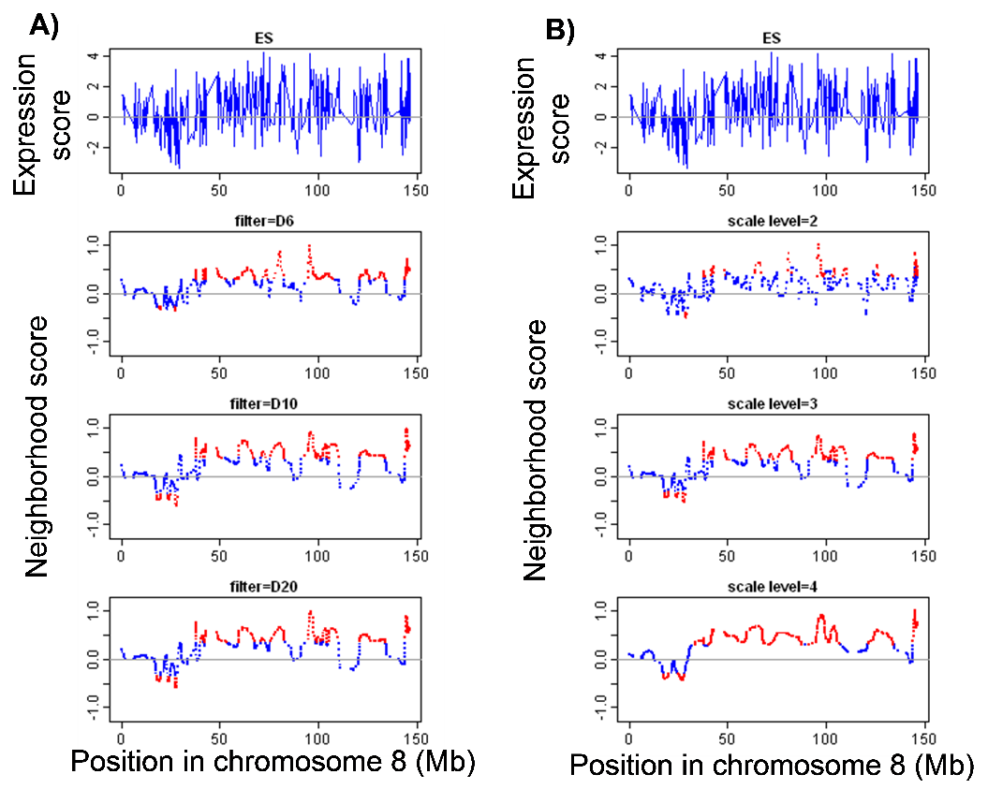
NS: parameter selection--scaling
The higher scaling level yielded a better overall global pattern, but at the cost of an attenuated local resolution.
the scaling level should be selected before the correlation coefficients between the raw and smoothed ES became effectively invariant with respect to changes in the scaling level.
We suggest the optimal scale was mathematically one point before the curve reached its maximal curvature at which the over-smoothing has happened.

Slide 24
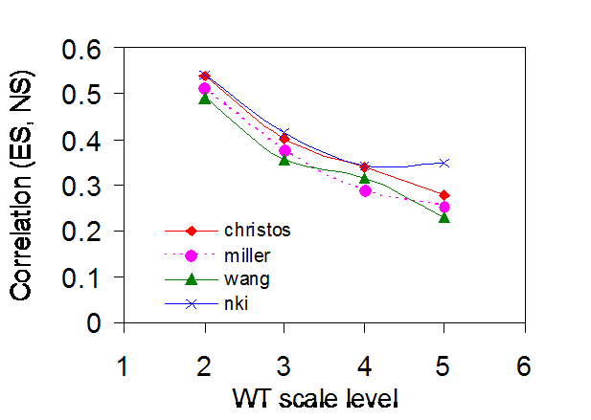
NS: parameter selection--scaling
The curves had maximal curvature at s = 4, so the scale s = 3 was selected as the optimal scale for all analyses related to the identification of CNV cis regulated genes
back

Slide 25
permutation
Why?
To access the significance of NS.

Slide 26
permutation
GACE VS WACE
Such a non-zero mean null distribution increases both type I and type II errors in the statistical evaluation of NS, since for the same magnitude, a negative NS could be assumed to be significant, but the respective positive NS was not.
Randomly assign class labels to each expression values of each gene
Shuffle the
t-statistics( or ES)
VS
back

Slide 27


GACE
Gaussian transform
Gaussian function:
back

Slide 28
results
Performance comparison of WACE and GACE
Amplified regions associated with poor outcome affect cell cycle
ICNV regions versus aCGH based regions
Breast Cancer Gene Regulatory Networks
Key Driver Analysis
Validation of key drivers via in vitro siRNA knockdown experiments

Slide 29
Performance comparison of WACE and GACE
improved GACE by introducing:
  a wavelet based smoothing technique
  a new statistical method for assessing significance of putative CNV regions.
Findings:
  WACE uncovered almost three times as many expression ICNV regions overlapping with the aCGH ICNV regions compared to GACE
  these two sets of regions identified by WACE were better correlated with each other than those identified by GACE.

Slide 31
(A)
GACE
commonly
identified loss
uniquely
9%
identified loss
30%
45%
16%
uniquely
commonly
identified gain
identified gain
(B)
WACE
commonly
uniquely
identified loss
identified loss
8%
9%
uniquely
36%
identified gain
47%
commonly
identified gain

Slide 32
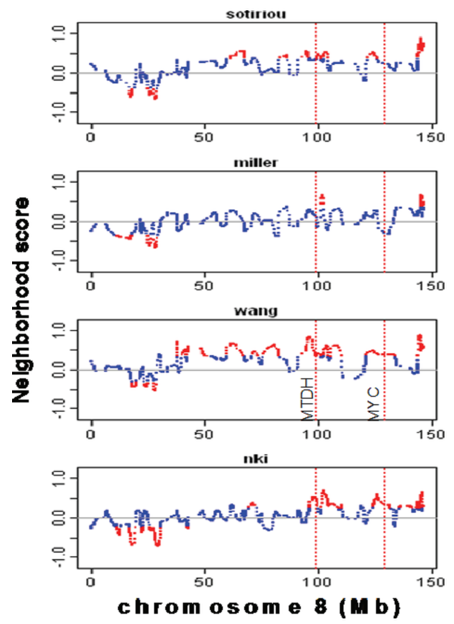
Amplified regions associated with poor outcome affect cell cycle

Slide 33
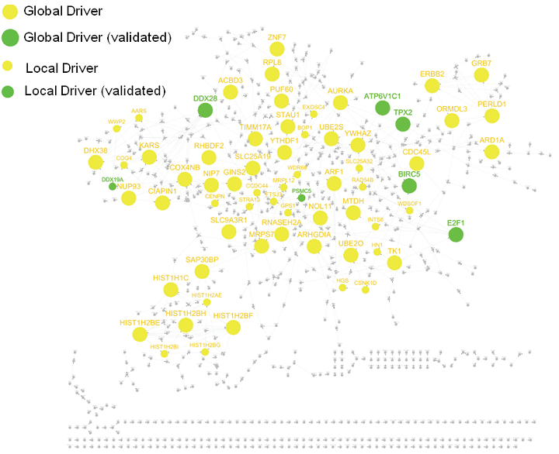
A regulatory network for the genes on the amplified recurrent ICNV regions
back

Slide 34
discussion
Limitation:
  We may miss kinases or enzymes that drive cancer progression and metastasis if these kinases’ or enzymes ’ activity changes are mainly due to protein level changes.
  Complementary proteomic approaches are needed to complement this approach.
back

Slide 35
Thank you

